Slide 1
Status Presentation
Team 4
Nick Kamarianakis
Douglas Raymond
Jacob Hawley
Neal Traynor
Will Rose

Slide 2
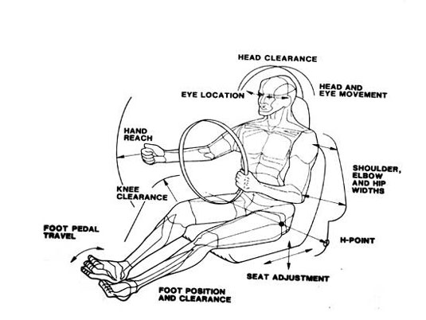
Adjustability
Knee Angle: > 135 °
Mean preferred: 122°
Trunk/Thigh Angle: < 90°
Mean preferred: 105 °
Back Angle: 10 ° - 30 °
Mean preferred: 28 °

Slide 3
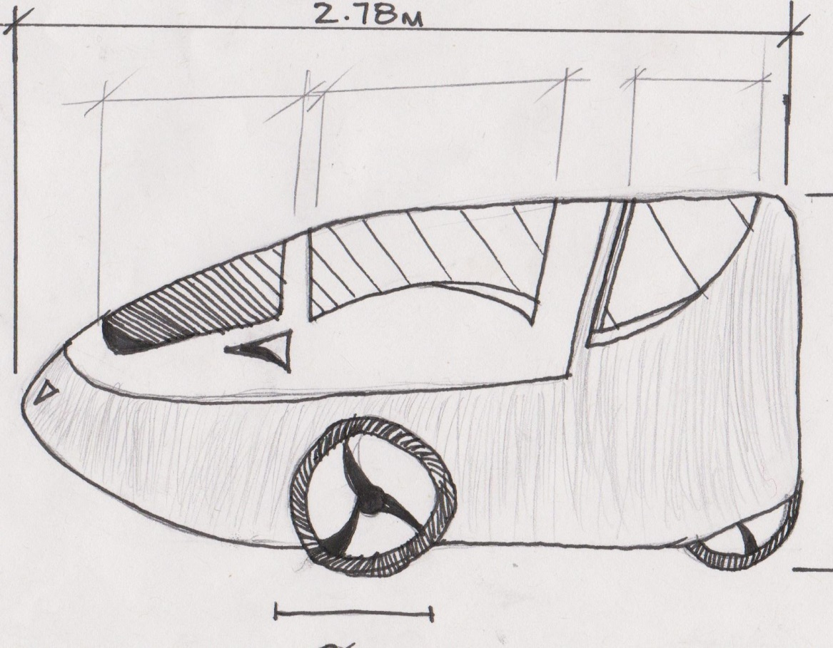
Shape and Size
Dimensions
2.78m long
0.85m wide
1.20m high
Shape
tailored to fit in a Canadian standard bike lane

Slide 4
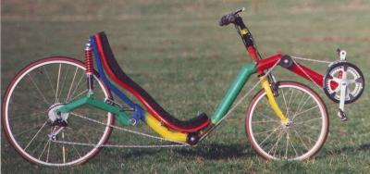
Frame
Force Distribution
Wheel base – 1 meter
Seat position – 70 centimeters
Centre of Gravity
Seat height

Slide 5
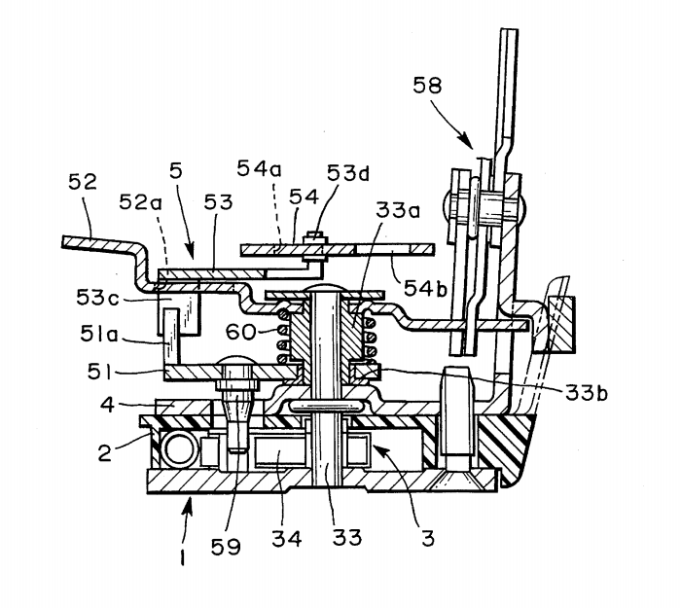
Locking and Security
Primary method is the vehicle door lock incorporated into the tricycle door
Backup method will be the bike lock attached to the tricycle
Average weight = 20-40 kg
Average size =
450mm X 450 mm

Slide 6
Materials
Housings
20% Glass-Filled
Polycarbonate

Slide 7
Conclusion
Thank You for Listening!
Questions?

